Slide 1

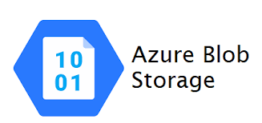




Near Real-Time Twitter feed dashboard in Snowflake using Azure
Problem Statement: Twitter feeds generated should be ingested to Snowflakes in real -time and it should power a in-built dashboard utility in Snowflakes to generate a report on the popularity of feeds.
Steps:
We should write API calls to fetch Twitter insights in real-time via python and this code can be run in local machine every day once
We need to create a snowpipe component in Snowflakes by using Azure IAM integration(cross-account access) as Snowflakes hosted on Azure account is different from the Azure account we own. This in turn uses Azure EventGrid and Function App in the backend to automate the file load
As soon as the script generates files in Azure Blob storage, Snowpipe recognises the file arrival and loads the snowflakes table with file data automatically
We create a dashboard in Snowflakes that is scheduled to refresh every 30 mins to show actual feed data from twitter. Ex) No of likes and comments/feed to understand popular feed and their sentiment
VM/Local Machine
Azure Blob Storage
Azure Queue

Slide 2
Steps:
Create an Azure account Free Trial(if possible) as it dependent on the email-id used for creating the account. If the email-id is already used then it might not be eligible for Free Trial. If Free trial is not possible, then choose “Pay as you go” Subscription where we will be billed based on our usage
Create Resource Group and ensure to choose it for all the resources we create for this project
Create a Storage Account. Ex) snowpipeaccount2022
Create a Container within that Storage Account. Ex) twitter
Create a Queue within that Storage Account. Ex) snowpipequeue
Create a Snowflakes Account hosted on Azure(for free with 300$)
Run the commands under the topic:”Snowflakes Commands”
Create a role in IAM of Storage Account with Storage Blob Contributor permission and assign it to Snowflakes service principal
Create a role in the IAM of Storage Queue and Storage Queue Contributor permission and assign it to Snowflakes service principal
Create a Twitter Developer account and copy the bearer token, Access keys
Run the script twitter_search.py by altering the connection string and twitter API credentials
Create a Dashboard by traversing through Snowflakes Marketplace and feed in the SQL given in “Dashboard Query” topic and choose the chart options as per the video to create a bar chart

Slide 3
Snowflakes Commands
//Create a Database and choose it to run next set of SQLs
create database twitter;
use twitter;
//Create a notification integration for Azure Storage queue
create notification integration SNOWPIPE_DEMO_NOTIFICATION_INT
enabled = true
type = queue
notification_provider = azure_storage_queue
azure_storage_queue_primary_uri = 'https://snowpipeaccount2022.queue.core.windows.net/snowpipequeue'
azure_tenant_id = '8e6e7e9e-940c-4115-a4a9-26bf16812d24';
Note: Replace with your subscription details

Slide 4
//Create a storage integration for Azure Blob Storage
CREATE STORAGE INTEGRATION SNOWPIPE_DEMO_INT
TYPE = EXTERNAL_STAGE
STORAGE_PROVIDER = AZURE
ENABLED = TRUE
AZURE_TENANT_ID = '8e6e7e9e-940c-4115-a4a9-26bf16812d24'
STORAGE_ALLOWED_LOCATIONS = ('azure://snowpipeaccount2022.blob.core.windows.net/twitter/')
//Create a stage for Azure files
CREATE STAGE MYSTAGE
url = 'azure://snowpipeaccount2022.blob.core.windows.net/twitter/files/'
STORAGE_INTEGRATION= SNOWPIPE_DEMO_INT;
Note: Replace with your subscription details

Slide 5
//Create a table and external stage pointing to Azure Blob Storage
create table twitter.public.dummy(input variant)
create stage twitter.public.mystage
url = 'azure://snowpipeaccount2022.blob.core.windows.net/twitter/files/'
storage_integration = SNOWPIPE_DEMO_INT;
//Create a Snowpipe to load staged files automatically as soon as they land
CREATE PIPE twitter.public.mypipe
auto_ingest = true
integration = 'SNOWPIPE_DEMO_NOTIFICATION_INT' as
copy into twitter.public.feeds
from @twitter.public.mystage
file_format = (type = 'JSON');
Note: Replace with your subscription details

Slide 6
//list all pipes in Snowflakes
show pipes
//describe al pipe in Snowflakes
desc pipe mypipe
//select rows from table
select * from dummy
select input:data[0]:public_metrics.like_count from twitter.public.dummy
//list the files in Snowflakes stage
list @twitter.public.mystage
//check the pipe status in Snowflakes
select SYSTEM$PIPE_STATUS( 'mypipe' )

Slide 7
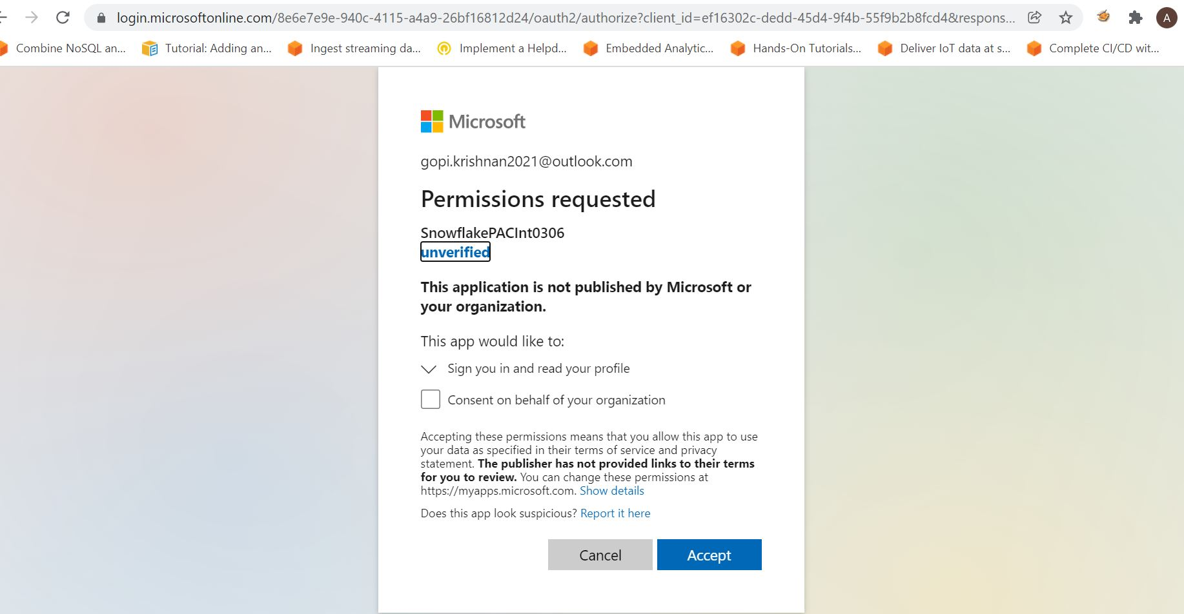
Sample Authorization page
//Describe Snowflakes integrations
desc integration SNOWPIPE_DEMO_NOTIFICATION_INT
desc integration SNOWPIPE_DEMO_INT
Note: Click on AZURE_CONSENT_URL column value and provide consent to link Azure with Snowflakes. Take a note of AZURE_MULTI_TENANT_APP_NAME column value. If its empty for Notification Integration, Copy the client_id from the consent URL redirect and run the following commands to get the App_display_name: az ad sp show --id <client_id> (Run this in cloud shell of Azure portal)

Slide 8
Dashboard Query
select distinct value:id,
to_number(value:public_metrics.like_count) as likes,
to_number(value:public_metrics.retweet_count) as retweets,
to_number(value:public_metrics.reply_count) as replies,
to_number(value:public_metrics.quote_count) as quotes
from twitter.public.dummy,lateral flatten(input=>input:data )

